Slide 1

Report Structure: The Shorter Forms
CHAPTER ELEVEN

Slide 2
Overview
Length and formality determine report structure
Characteristics of short reports
Direct and indirect order for organizing short reports
Forms of short reports
Forms of special reports

Slide 3
Length and Formality Determine Report Structure
Long problems and formal contexts require a more complex structure
Short problems and informal contexts need a simpler structure

Slide 4
High formality
1st
Step
Title
Fly
Title Page
Letter
of
Trans.
Table
of
Contents
Executive
Summary
THE REPORT PROPER
2nd Step
Title Page
Letter
of
Trans.
Table
of
Contents
Executive
Summary
THE REPORT PROPER
3rd Step
Title Page
Table
of
Contents
Combination
Transmittal/
Exec.Sum.
THE REPORT PROPER
4th Step
Title Page
Combination
Transmittal/
Exec.Sum.
THE REPORT PROPER
5th Step
Title Page
THE REPORT PROPER
6th Step
LETTER REPORT
7th Step
MEMO
REPORT
Low formality

Slide 5
Characteristics of Short Reports
Little need for introductory information
Predominance of direct order
More personal writing style
Less need for a structured coherence plan

Slide 6
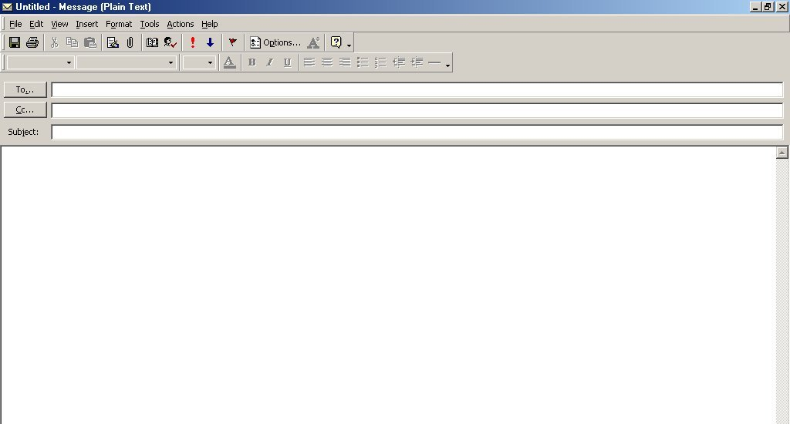
Illustration of an Email Report,
Direct Order (1 of 3)
Jeff T. Koontz
Quality of Plant Fire Protection
Recommended action.
My investigation of the quality of fire protection at the plant supports these recommendations:
1. That the Safety Supervisor conduct training sessions for each fire brigade until it is thoroughly trained.
2. That monthly practice runs be scheduled for all fire brigades.
3. That an alarm bell be placed outside the Shift Maintenance office in
Building 135.

Slide 7
Illustration of an Email Report,
Direct Order (2 of 3)
That four standard fire extinguishers be placed in Building 135.
That the entire plant be inspected to determine the adequacy of fire extinguishers.
Purpose of investigation.
These recommendations are based on information gathered from my investigation following the fire in the Calcination Department, Building 133, last July 14. As you will recall, you asked me to look into the quality of our fire protection. Following are my findings.
Training deficiency of fire brigade.
Although they worked hard to put out the fire, the fire brigade was not effective. It was obvious to all present at the scene (including brigade members) that the brigade had not been trained properly. Brigade members had difficulty working the pump and generally did not perform as a coordinated unit.

Slide 8
Illustration of an Email Report,
Direct Order (3 of 3)
Inadequacy of alarm system.
The plant alarm was not heard in Building 135 (the fire brigade work area). A telephone call was needed to alert brigade members. Thus, about seven minutes were lost before fire-fighting work began.
Shortage of fire extinguishers.
The supply of fire extinguishers in the fire area was inadequate. So brigade members had to go to other work areas to find the fire extinguishers. The result was a loss of valuable fire-fighting time and unnecessary fire damage. Informal reports received from workers in other parts of the plant indicate that the shortage of fire extinguishers is plantwide.

Slide 9
Illustration of a Memorandum Report, Indirect Order (1 of 3)
Jeff T. Koontz
Quality of Plant Fire Protection
Introduction.
Following the fire in the Calcination Department July 14, you instructed me to investigate the quality of our fire protection. My investigations revealed the following deficiencies.
Training deficiency of fire brigade.
Although they worked hard to put out the fire, the fire brigade was not effective. It was obvious to all present at the scene (including brigade members) that the brigade had not been trained properly. Brigade members had difficulty working the pump and generally did not perform as a coordinated unit.

Slide 10
Illustration of a Memorandum Report, Indirect Order (2 of 3)
Inadequacy of alarm system.
The plant alarm was not heard in Building 135 (the fire brigade work area). A telephone call was needed to alert brigade members. Thus, about seven minutes were lost before fire-fighting work began.
Shortage of fire extinguishers.
The supply of fire extinguishers in the fire area was inadequate. So brigade members had to go to other work areas to find the fire extinguishers. The result was a loss of valuable fire-fighting time and unnecessary fire damage. Informal reports received from workers in other parts of the plant indicate that the shortage of fire extinguishers is plantwide.

Slide 11
Illustration of a Memorandum Report, Indirect Order (3 of 3)
Recommended actions.
Based on the information reported , I make these recommendations:
1. That the Safety Supervisor conduct training sessions for each fire
brigade until it is thoroughly trained.
2. That monthly practice runs be scheduled for all fire brigades.
3. That an alarm bell be placed outside the Shift Maintenance office
in Building 135.
4. That four standard fire extinguishers be placed in Building135.
5. That the entire plant be inspected to determine the adequacy of
fire extinguishers.

Slide 12
Forms of Short Reports
Short Report
Letter Report
Email Report
Special Report

Slide 13
Special Report Forms
Staff Report
Meeting Minutes
Progress Report
Audit Report
Proposal

Slide 14
“Success is the maximum utilization of the ability that you have.”
--Zig Ziglar

